Slide 1



a00s3e3 - DONE
F= -1.77969
F = -1.77893
F= -1.77588, unstable

Slide 2










a00s5e3 - DONE
F = -2.986
F = -2.98574
F = -2.98733
F = -2.98580
F = -2.98637
F = -2.98644

Slide 3


a00s6e3 - DONE
F = -3.59170
F = -3.59404

Slide 4


a00s7e3 - DONE
F = -4.20090
F = -4.20224
Terran tried stripe (15.2, 20.2) & (12.2, 20.2). Unstable

Slide 5



a05s3e3 - DONE
F = -1.77283
F = -1.77232
F = -1.77005

Slide 6



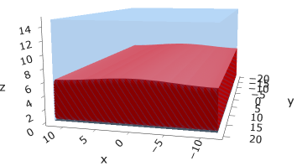
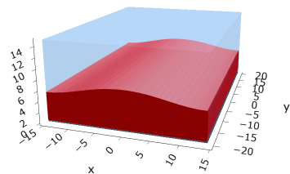
a05s5e3
F = -2.97229
F = -2.97422
F = -2.97319
F = -2.97365

Slide 7



a05s6e3 - TERRAN
F = -3.57664
F = -3.57732
F = -3.57783

Slide 8



a05s7e3 - DONE
F = -4.18090
F = -4.18116
F = -4.18226

Slide 9
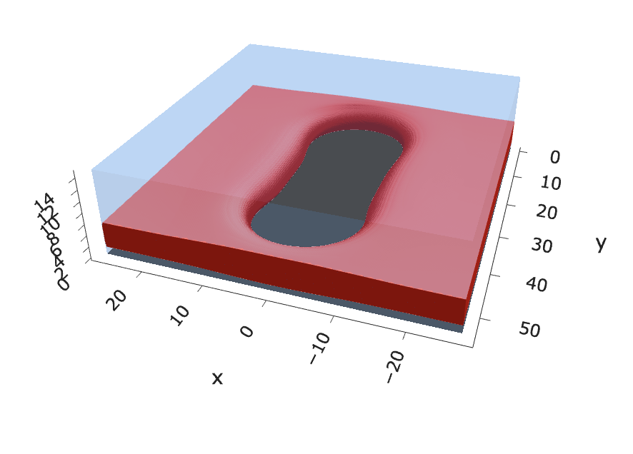
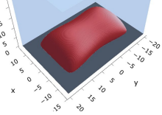
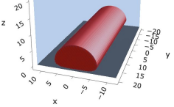
a10s2.5e3 - JOSH
F = -1.45894
F = -1.45840
F = -1.45357

Slide 10
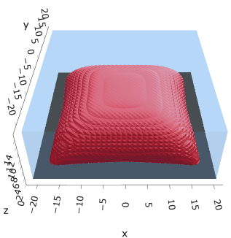
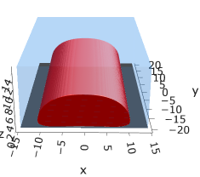
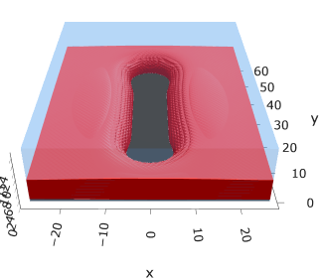
a10s3.75e3
F = -2.19744
F = -2.19763
F = -2.19618

Slide 11
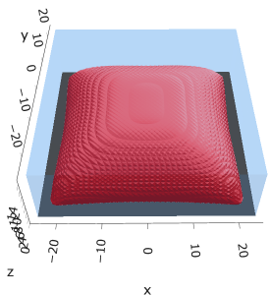


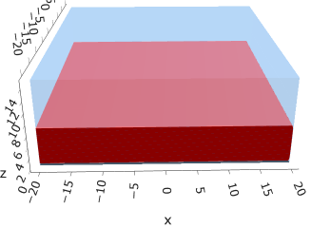


a10s5e3
F = -2.93747
F = -2.93851
F = -2.93859
F = -2.93848

Slide 12

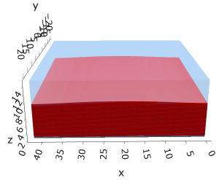

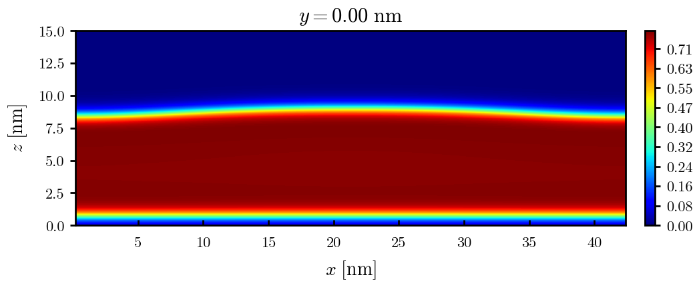
a10s0075
F = -4.42442
F = -4.42465
F = -4.42466

Slide 13


a10s010 - DONE
F = -5.90899
F = -5.90938
Josh tried hole. Unstable

Slide 14
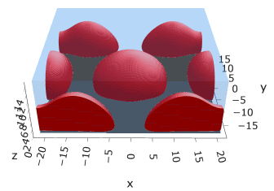
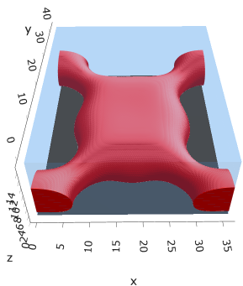
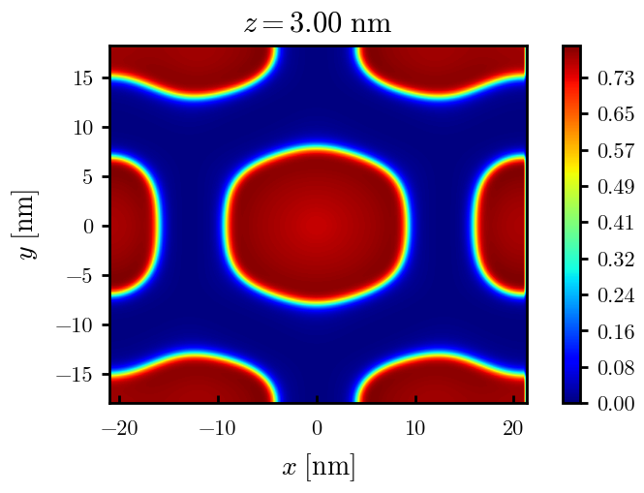
a15s2.5e3

Slide 15
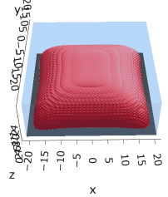



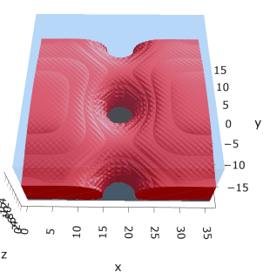
a15s5e3
F = -2.88508
F = -2.88602
F = -2.88482
F = -2.88654

Slide 16
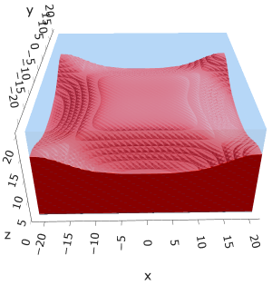

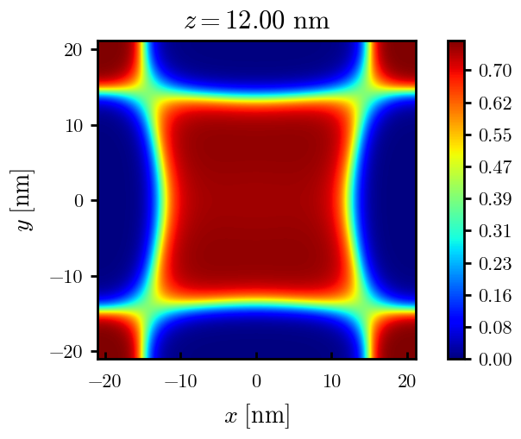
a15s1e2
F = -5.78561
F = -5.78588
Tried hole and didn’t work

Slide 17
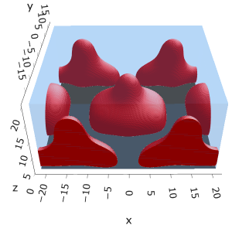
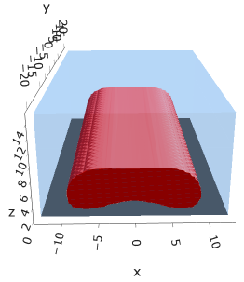
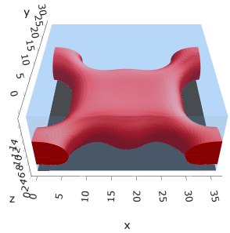
a20s2.5e3
F = -1.41058
F = -1.41046

Slide 18

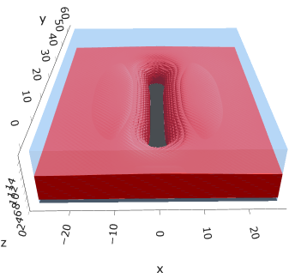
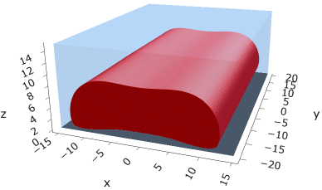
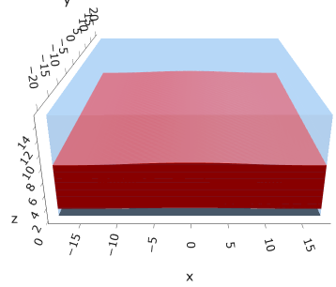
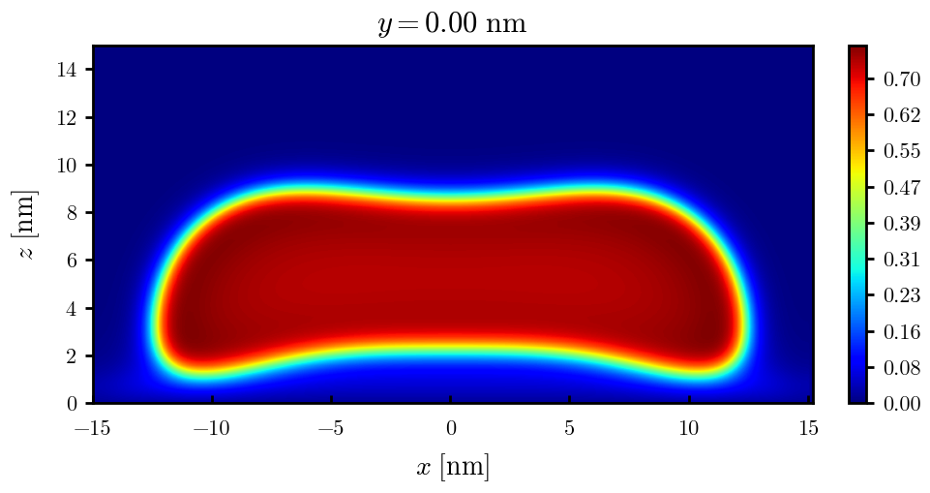
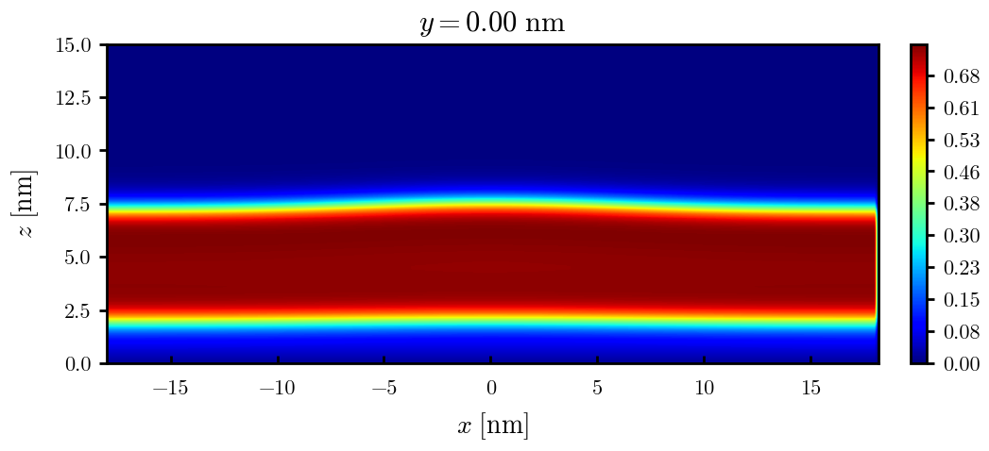
a20s5e3
F = -2.82154
F = -2.82217
F = -2.82208
F = -2.82020

Slide 19
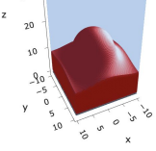
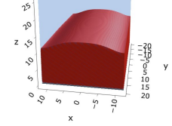
a20s010
F = -5.63481
F = -5.63514

Slide 20


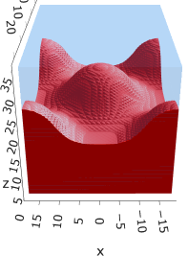
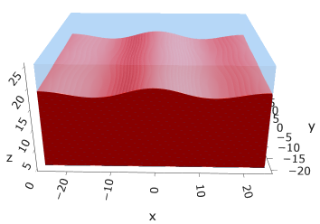
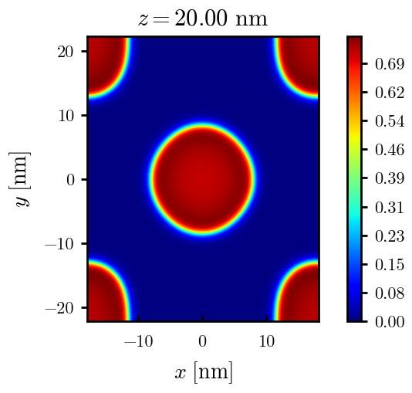
a20s015
F = -8.44011
F = -8.44081
F = -8.43935
F = -8.43930
n_coarse = 2

Slide 21



a20s0175
F = -9.83777
F = -9.83863
F = -9.83859

Slide 22




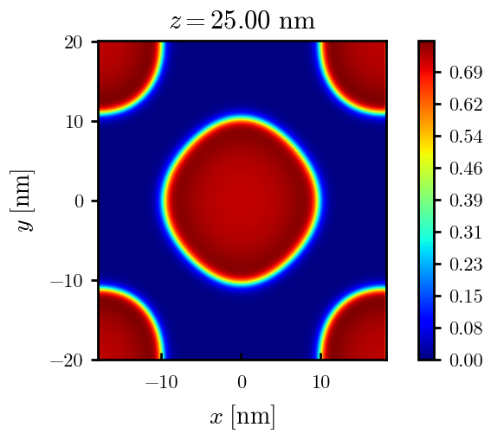
a20s020
F = -11.2312
F = -11.2319
F = -11.2321
n_coarse = 2

Slide 23



a20s022 – DONE
F = -12.3420
F = -12.3429
F = -12.3433

Slide 24




a20s025 - DONE
F = -14.0028
F = -14.0029
F = -14.0033
F = -13.9755

Slide 25




a20s027 - DONE
F = -15.1049
F = -15.1047
F = -15.0898
F = -15.1050

Slide 26
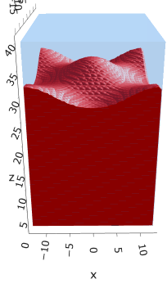
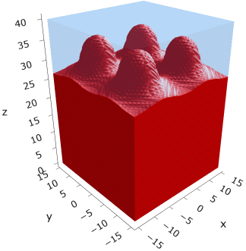
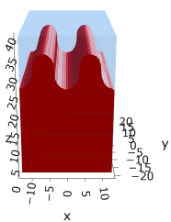
a225s025
F = -13.7769
F = -13.7774
F = -13.7775

Slide 27
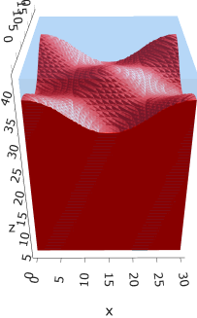
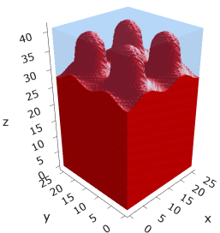
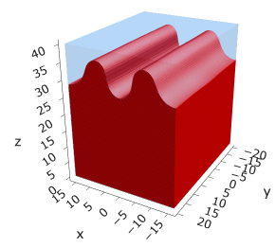
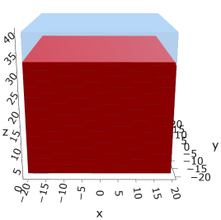
a225s0275
F = -15.1288
F = -15.1293
F = -15.1292
F = -15.1293

Slide 28
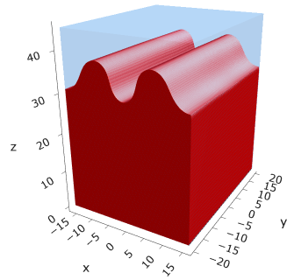
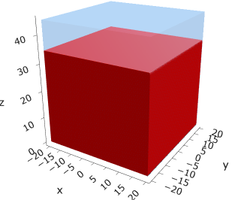
a225s030
F = -16.4742
F = -16.4743

Slide 29
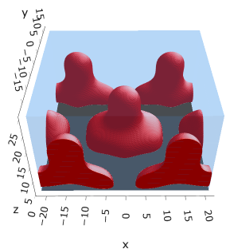
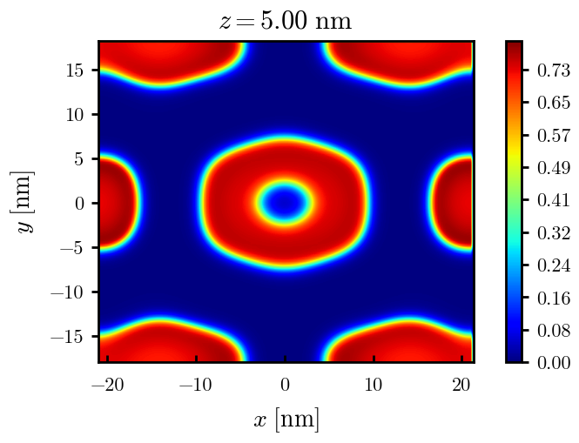
a25s2.5e3
It = 43

Slide 30
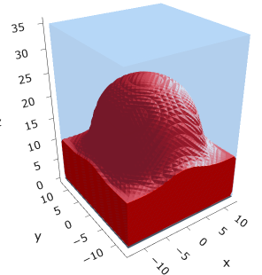
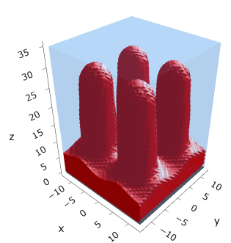
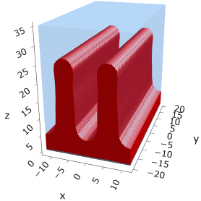
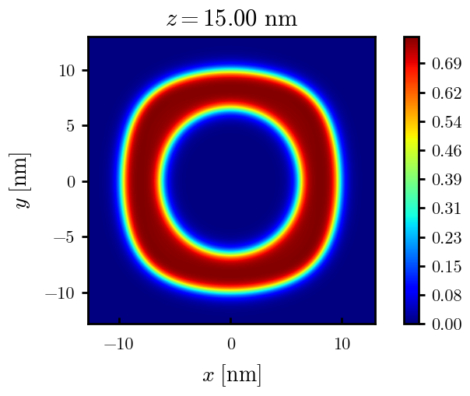
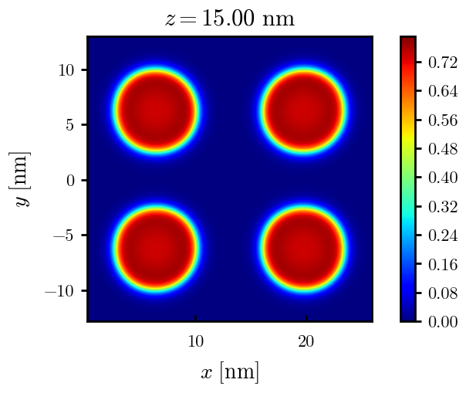
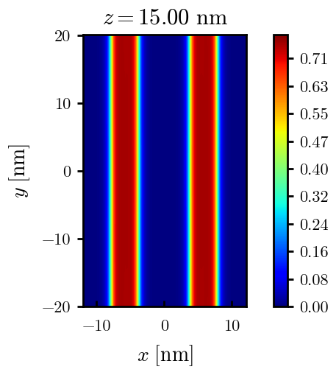
a25s010
F = -5.47583
F = -5.48308
F = -5.48457

Slide 31












a25s015
F = -8.18187
F = -8.17785
F = -8.18516
F = -8.18653
F = -8.18878
F = -8.18865

Slide 32










a25s015 – cyl <> cyl-str
F = -8.18470
F = -8.18421
F = -8.18550
F = -8.18563
F = -8.18589

Slide 33






a25s020
F = -10.8712
F = -10.8748
F = -10.8775
F = -10.8766

Slide 34




a25s025
F = -13.5406
F = -13.5450
F = -13.5463
F = -13.5461

Slide 35






a25s027
F = -14.6059
F = -14.6065
F = -14.6030
F = -14.6015
F = -14.6022
F = -14.6018

Slide 36







a25s030
F = -16.1888
F = -16.1896
F = -16.1896
F = -16.1854
F = -16.1854
F = -16.1858
F = -16.1857

Slide 37






a25s0325
F = -17.4997
F = -17.4998
F = -17.4968
F = -17.4973
F = -17.4971
F = -17.4975

Slide 38




a25s035
F = -18.8025
F = -18.8025
F = -18.8000

Slide 39


a25s040
F = -21.3805
F = -21.3796

Slide 40

a30s0025

Slide 41


a30s005

Slide 42

a30s015

Slide 43









a30s020
F = -10.5092
F = -10.5098
F = -10.4996
F = -10.4878
F = -10.4764

Slide 44





a30s025
F = -13.0657
F = -13.0668
F = -13.0548
F = -13.0538
F = -13.0394

Slide 45






a30s030
F = -15.5953
F = -15.5956
F = -15.5886
F = -15.5897
F = -15.5739

Slide 46





a30s0325
F = -16.8494
F = -16.8486
F = -16.8312
F = -16.8491
F = -16.8268
2C isomin = 0.5

Slide 47






a30s035
F = -18.0779
F = -18.0943
F = -18.0948
F = -18.0946
F = -18.0887
F = -18.0782

Slide 48









a30s040
dz =0.15
F = -20.5583
F = -20.5585
F = -20.5582
F = -20.5549
F = -20.5390
F = -20.5384

Slide 49







a30s045
n_coarse = 2
dz =0.15
F = -22.9834
F = -22.9822
F = -22.9788
F = -22.9692
F = -22.9716

Slide 50





a30s050
dz =0.15
F = -25.3647
F = -25.3647
F = -25.3619
F = -25.3553
F = -25.3480

Slide 51




a30s055
F = -27.6992
F = -27.6993
F = -27.6917
n_coarse = 3

Slide 53




a30s020, chi = 1.35
F = -10.3763
F = -10.3644
F = -10.3602
F = -10.3437

Slide 54





a30s040, chi = 1.35
F = -20.3489
F = -20.3492
F = -20.3446
F = -20.3275
F = -20.3219

Slide 55


a325s020
F = -10.2994
F = -10.2821

Slide 56




a35s020
Cyl?
3 “layers”
+1 dilute layer < isomin = 0.1

Slide 57





a35
s10
s12
s15
s18

Slide 58



Parallelization
$$α=0, χ=1.25, N=50, σ=0.02$$
$$α=0, χ=1.25, N=200, σ=0.005$$
$$L_{x}=L_{y}=23, { L}_{z}=15$$
Nth = 12: 500 it, 4.3 hrs
Nth = 8 : 500 it, 6.9 hrs
Nth = 6 : 415 it, 20 hrs (poss. mem bottleneck)

Slide 59







Exercise: Micelle / Stripe
s = 5e-03, N = 50, a = 0.0, x = 1.0
s = 5e-03, N = 75, a = 0.0, x = 1.0
Isosurface at pha = 0.1

Slide 60






a040x170s020

Slide 61






a040x170s010

Slide 62

a040x170s025

Slide 63














a040x170s022

Slide 64










a040x170 seed
See if becomes hex
cyl4-975
cyl4-12
cyl16-975
cyl16-1025
cyl1

Slide 65






a040x170s017

Slide 66












































a040x170s015 seed
Almost done
Almost done

Slide 67

















a040x170s013

Slide 68
















a040x170s010 seed

Slide 69














X200 x170 x130 x120 x100
F = −10.24458
F = − 9.14301
F = −11.0057
F = −10.2429
F = −11.0015
F = −9.63949
F = −10.2461
F = −10.9948
F = − 9.63030
F = −10.2431
F = −10.9953

Slide 70





a040x100 relaxation

Slide 71








































a040x100 seed
old
old

Slide 72


a040x120 relaxation
F = −10.24458

Slide 73





































a040x120 seed
cyl16-850
cyl16-825

Slide 74






a040x130 relaxation

Slide 75




a040x170 relaxation
F = −9.10347
1 neck

Slide 76







a040x200 relaxation

Slide 77










a040x200 seed
Note: not completely converged but stopped for resources

Slide 79


a0.40 x1.70

Slide 80





Zhulina JCP 1998
a = 0.01
0.1 mM
1 mM
May need to init using sine
10 mM
25 mM
Zhulina NVT; current GCE runs at Lz = 20

Slide 81

Carrillo Langmuir 2009

Slide 82

Parallelization

Slide 83
Equations
Quenched average, np, A --> \inf ; np/A → \sigma
Discrete Gaussian chain

Slide 84




Scaling (Alexander—de Gennes brush)
V = 4.2; H = 27.5 – 30.5
V = 2; H = 39 – 45.5

Slide 85







$φ_{p}$: DGC (3D; NxNy=1) vs MDE (1D)
Ns/sigs: dz = 0.10, Ngz_2 = 4$σ$; Chis/bs: dz = 0.25, Ngz_2 = 3.5$σ$

Slide 86


Numericals
Ys
Possibly do Ngz for multiple dzs

Slide 87








3D
Lxy = 1
Lxy = 10
Lxy = 5
Lxy = 15
y-z heatmaps for $φ_{p}$ at constant x

Slide 88





z-FFT vs z-FD (MDE) – REDFT01 xy(z)
Lx = 5, Ly = 5, Lz = 50. s = 0.02. x = 0.75. a = 0.00, N = 50
3D vs 1D (dashed): dz = 0.5, ds = 0.20; dz_1D = 0.113, ds_1D = 0.083
FFT (xyz)
FFT (yz vs pha)
FD (xyz)
FD (yz vs pha)
Diff btw 1D/3D should just be dz, ds, etc.

Slide 89
Specifying Grafted Points

Slide 90
Strategy
2D binary array for surface sites of homogeneously grafted polymer given grafting density, simulation box size, and discretization (and assuming dx = dy)
Fullspace must be periodic on x0 = xL, y0 = yL
Halfspace must be even on xL/2 and yL/2 (overlap of boundary following REDFT00) and periodic on x0 = xL, y0 = yL.
Homogeneous spacing as determined by regular hexagon, where grafting point at centroid of hexagon
In case there are edge effects, try shifting the centroids away from the boundaries of the xy-plane (only did for fullspace)
Make sure no edge effects by comparing results of full FFT with cos FFT

Slide 91
Test conditions
Sigma = 0.05 c/nm2
Lx = 15 nm
Ly = 15 nm
dx = 0.4 nm
Cast in terms of dx (for rounding and PBC for grafting points):
Sigma = 0.0668 c/nm2
Lx = 14.80 nm
Ly = 11.20 nm
(Sigma error decrease with dx)

Slide 92

Padded PBC (Full FFT)
Hexagons drawn for illustration of hexagon approach

Slide 93

Unpadded PBC (Full/Cos FFT)

Slide 94






Other conditions (full and half results overlapped to show match)
s = 0.0241 (20.28%; dx=0.4), Lx, Ly = 12.40, 20.80
s = 0.0208 (4.08%; dx=0.1), Lx, Ly = 12.90, 22.30
s = 0.1332 (11%; dx=0.1), Lx, Ly = 20.50, 20.40

